Slide 1

Department of Information Science and Engineering
Academic year: 2022-23
Project Phase - II – Review II Presentation
“NUMBER PLATE RECOGNITION (NPR) USING IMAGE PROCESSING TECHNOLOGY”
PROJECT TEAM:
1. Abhishek Chaudhary (1DB19IS003)
2. Akhilesh (1DB19IS004)
3. Hasan Raihan (1DB19IS030)
4. Neel Mitesh Patel (1DB19IS054)
GUIDE:
Roopashree M S,
Assistant Professor,
Department of ISE,
DBIT, Bengaluru
title of the project to be included here

Slide 2
Contents
Index
Introduction
Problem Statement
Objectives
Prototype design/model
Progress of the work done after coding
Methodologies Used
Implementation
Output Discussion
Conclusion
Future Enhancement
References

Slide 3
Introduction
The need for Automatic Number Plate Recognition system arose when the number of vehicles on roads drastically increased and the recognition by a human eye became difficult
Automatic Number plate Recognition system can provide you with the details regarding when someone was at a particular premises, whenever they are required.
Its application ranges from parking admission to monitoring urban traffic and to tracking automobile thefts.

Slide 4
Problem Statement
Authorities find it very hectic on a busy day to log the vehicle numbers manually.
In order to make the entire process autonomous, we can install this system so as to automatically detect the vehicle.
We considered the vehicle as input image, system analyses and extracts the number plate from the input image.

Slide 5
Objectives
The process of manual data entry used by several industries garners a high error rate. This is because the manual process relies too heavily on a human's capability to interpret handwritten forms.
To reduce the high error rate of data entry, the researchers explored the different processes that comprise optical character recognition (OCR) and used it on a novel digital conversion model for hand-filled forms.
Optical character recognition is the process of converting characters from image format to text format. The process includes four main stages namely: pre-processing, feature extraction, character recognition, and post-processing.
The success is mainly based on the feature extraction method and the character recognition algorithm.

Slide 6
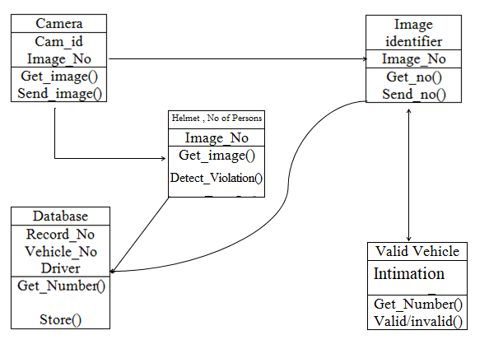
Prototype Design/Model

Slide 7
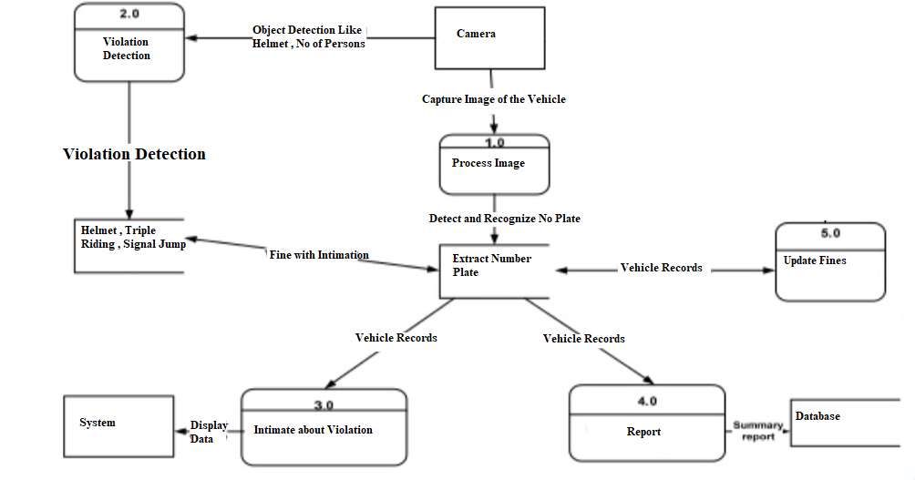
Progress of the Work Done After Coding

Slide 8
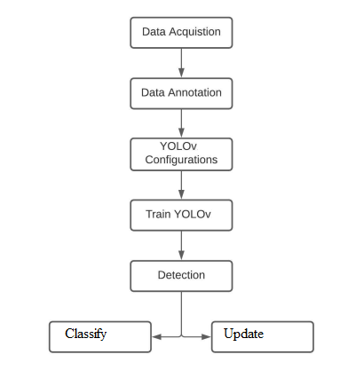
Methodologies Used
Reading and visualizing images using Yolo & OCR with Python.
Yolo object detection algorithm is used for detection and classification.
Applying color shifts and changes to images
Detecting image in the form of different shapes
Selecting the number plates to improve text extraction for OCR
Extracting number plate text using EasyOCR
The biggest advantages of Yolo is it superb speed.

Slide 9
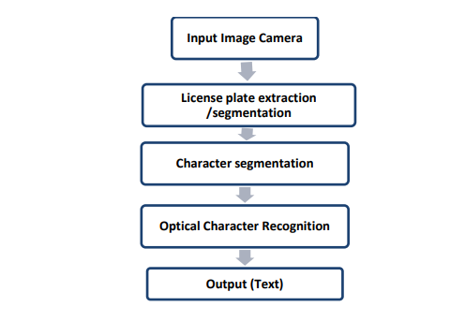
Implementation
Number plate recognition basically consists of the following steps:
Number Plate Extraction
Detection of Helmet & Triple Riding
Character Segmentation
Template Matching
Fig : implementation for Number Plate Extraction

Slide 10
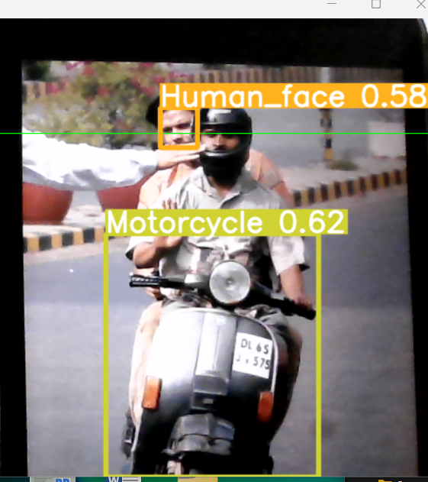
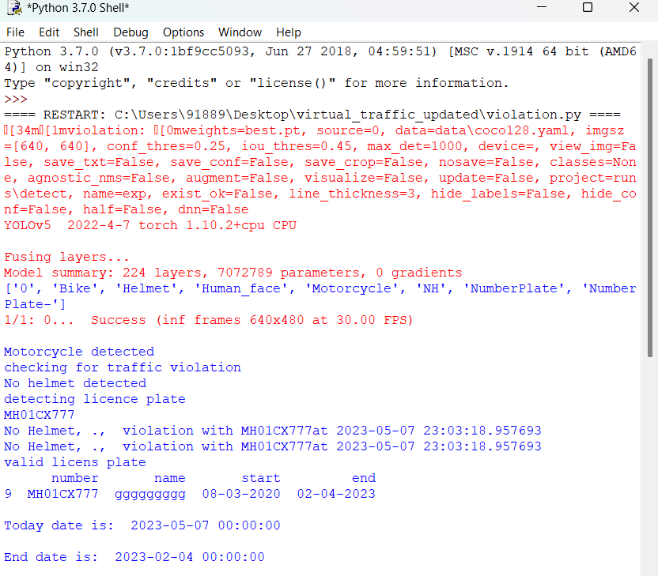
Output Snapshots
Fig 1 : Detecting Motorcycle and human face
Fig 2 : Result of detection

Slide 11
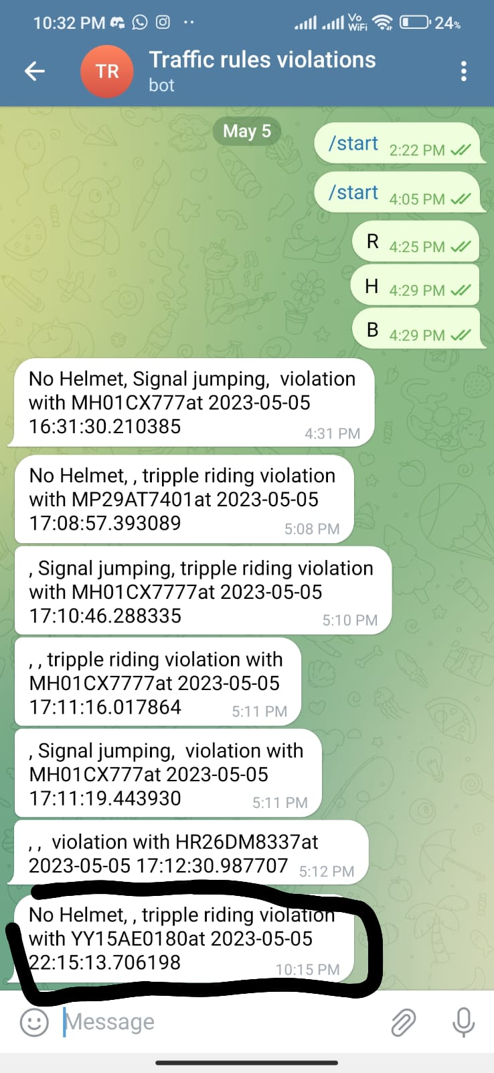
Output Snapshots
Fig 3 : Telegram Notification

Slide 12
Conclusion
The automatic number plate recognition system using vehicle license plate is presented. The system use image processing techniques for identifying the vehicle from the database stored in the computer.
The system works satisfactorily for wide variation of conditions and different types of number plates. It is implemented and executed in OpenCV and performance is tested on genuine images.
With successful identification of objects and edge detection technique the character recognition can be done to extract characters from the number plate image selected.
title of the project to be included here

Slide 13
References
[1] Traffic Rules Violation Detection using Machine Learning Techniques. Authors: P. Srinivas Reddy, T. Nishwa, R. Shiva Kiran Reddy, Ch Sadviq , K. Rithvik, IEEE 2021
[2] An Efficient FPGA Implementation of Optical Character Recognition for License Plate Recognition, Authors: Yuan Jing, Bahar Youssefi, Mitra Mirhassani, 2017 IEEE 30th Canadian Conference on Electrical and Computer Engineering (CCECE)
[3] Autonomous Vehicle And Real Time Road Lanes Detection And Tracking, Authors: Farid Bounini, Denis Gingras, Vincent Lapointe, Herve Pollart, 2015 IEEE
[4] Vehicle Number Plate Detection and Recognition using Bounding Box Method, Authors: Mahesh Babu K, M V Raghunadh, 2016 International Conference on Advanced Communication Control and Computing Technologies (ICACCCT)
[5] Dynamic Traffic Rule Violation Monitoring System Using Automatic Number Plate Recognition with SMS Feedback, Authors: R Shreyas, Pradeep Kumar B V, Adithya H B, Padmaja B, 2017 2nd International Conference on Telecommunication and Networks

Slide 14
Future Enhancement
Deep Learning Advancements: Utilizing advanced deep learning algorithms can enhance accuracy and speed, enabling robust number plate recognition even in challenging scenarios like low-light conditions or occlusions.
Real-Time Processing: Future systems can focus on achieving real-time processing, allowing for immediate identification of vehicles. This enables applications such as automated toll collection, parking management, or law enforcement activities.
Improved Accuracy and Reliability: Enhancements in image processing techniques and hardware capabilities can lead to increased accuracy, reducing false positives and negatives, even in scenarios with blurred or distorted plates.

Slide 15

title of the project to be included here

